Slide 1
Some business marketing aspects of optometry during digital development
Diana rabi

Slide 2
Lecture Outline
Introduction
Job satisfaction
Owner or investor
Debt definition
Leese agreement
Marketing plan
Summary
Product definition
easy optical marketing tips
Digital marketing strategies

Slide 3
Job satisfaction

Slide 4
How optometrist define job satisfaction
Job satisfaction means many different things. For some, job satisfaction means 45 percent net at the end of the year and over $300,000 in take-home pay. For others, job satisfaction may be getting off work early enough to greet their children as they step off the school bus.

Slide 5
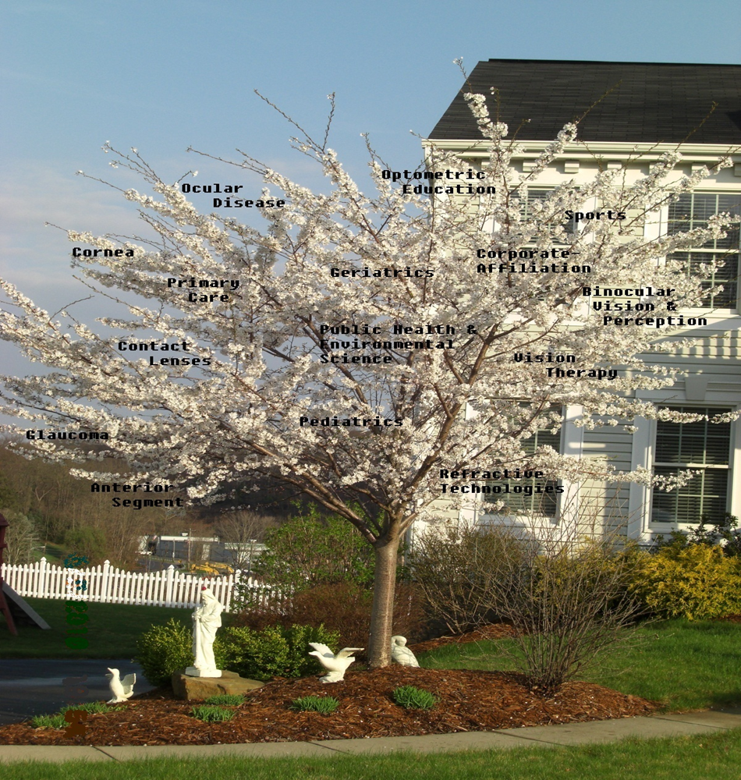
Three non-financial aspects of job satisfaction.
Autonomy –To have the freedom to work when we want, how we want, and how often we want supersedes the carrot of financial freedom and a comfortable retirement at the end of the road. Yes, we want to be paid well, but much more importantly we want to enjoy the journey.
Flexible schedule – now more than ever, a flexible schedule that allows freedom to pursue other interests or attend to family matters has become as important–if not more important–than financial compensation.
Clinical mosaic – practicing full-scope optometry in a setting that embraces the medical model leads to a variety of tasks that can be extremely fulfilling. The associate optometrists who I have talked to who are unhappy with their jobs spend nearly all of their time doing refractions and contact lens fittings.
Notes:
Whether it is a commercial setting or a private practice that doesn’t embrace the medical model, working in an environment that lacks the equipment and means necessary to practice all aspects of optometry will be less satisfying. Finding a practice with great financial compensation and a clinical mosaic can be very fulfilling professionally and should be part of your job satisfaction definition

Slide 6
Owner or Investor? what does work for optometrist
Dreams give us something to shoot for, and keep us going when things are difficult.
Friend and people ask what you do. You feel your chest puffing out as you proudly say, “My name vision.”

Slide 7
Owner | Investor
Makes or delegates all the decisions | Not part of day-to-day operations
Works all day Saturday should an associate be ill | Can count on having weekends off
Requests his or her family to be flexible with schedule | Goes home at the same time every night
May go a day or two of the week not seeing the children | Will most likely see the children everyday if desires
Financially benefits the greatest from the risk and sacrifice. | Financial benefit has no upward limits
Makes up the difference should the bills exceed the production. | Protected from downside limits of losing only what was invested.
Double stress of clinical responsibilities and day-to-day operation responsibilities. | Clinical stress

Slide 8
Debt ?!!
Debt is a lot like handcuffs that limit you from taking opportunities when they arise, opportunities that directly impact what your career in optometry will look like.

Slide 9
Debt handcuffs you in these three areas:
Buying an optometry practice
Investing to generate non-optometry related income
Growing your optometry business
Notes:
Many graduating optometrists want to buy a practice or be part of owning an optometry practice, but many are handcuffed to school loans that require a $1,000 or more monthly payment.
With those large regular payments, many don’t feel they can put any extra towards the principal and pay off the loan early. Or, they would rather not live as poor college students while doing so. Or any loan you already have.
Whether you are in solo practice or part of a group, there will be a limit to how much you can realistically leverage for practice growth. Individual debt choices directly impact business decisions amongst partners. The partner (or partners) who are debt free may want to move ahead with practice acquisitions or bringing in an associate.
Those partners may want to pay cash or acts as their own bankers, while the debt-handcuffed partner cannot get on board due to personal limitations.
– Most everyone dreams of someday being financially independent. If not having the money to retire, at least having the freedom to take time off to raise children or follow a personally fulfilling passion.
Leveraging debt could allow this, but usually ends up handcuffing us much longer than we initially calculate. If you do not have debt 10 years out of optometry school, think about having the finances to purchase the building you practice optometry in.

Slide 10
Lease agreement
Many high NET optometry practices continue to thrive due to lower overall costs, with occupancy being a cost that comes directly off the bottom line.
If you are an optometry practice paying more than 7% on occupancy, then you may want to renegotiate your lease agreement. If you are in the process of agreeing on a lease or will sometime in the near future,

Slide 11
Keep in mind!!
Start negotiations here – There are two main areas to start negotiating that will determine your overall occupancy cost for the practice.
The term of the lease and the rate. It is recommended that a 1-2 year lease with the option to renew.
Keep in mind that rent increases and renewal should be considered
Notes:
Beyond the Lease – What additional expenses will the landlord expect you to pay for? Will you have to pay additional amounts for land upkeep, or how about utilities? Ask for typical additional expenses that tenants have when they have leased this property in the past. Remember this is factored into your 7% occupancy rate for your Optometry Practice Budget.

Slide 12
Photo Collage

Slide 13
Marketing Plan
Update on the plan and progress

Slide 14
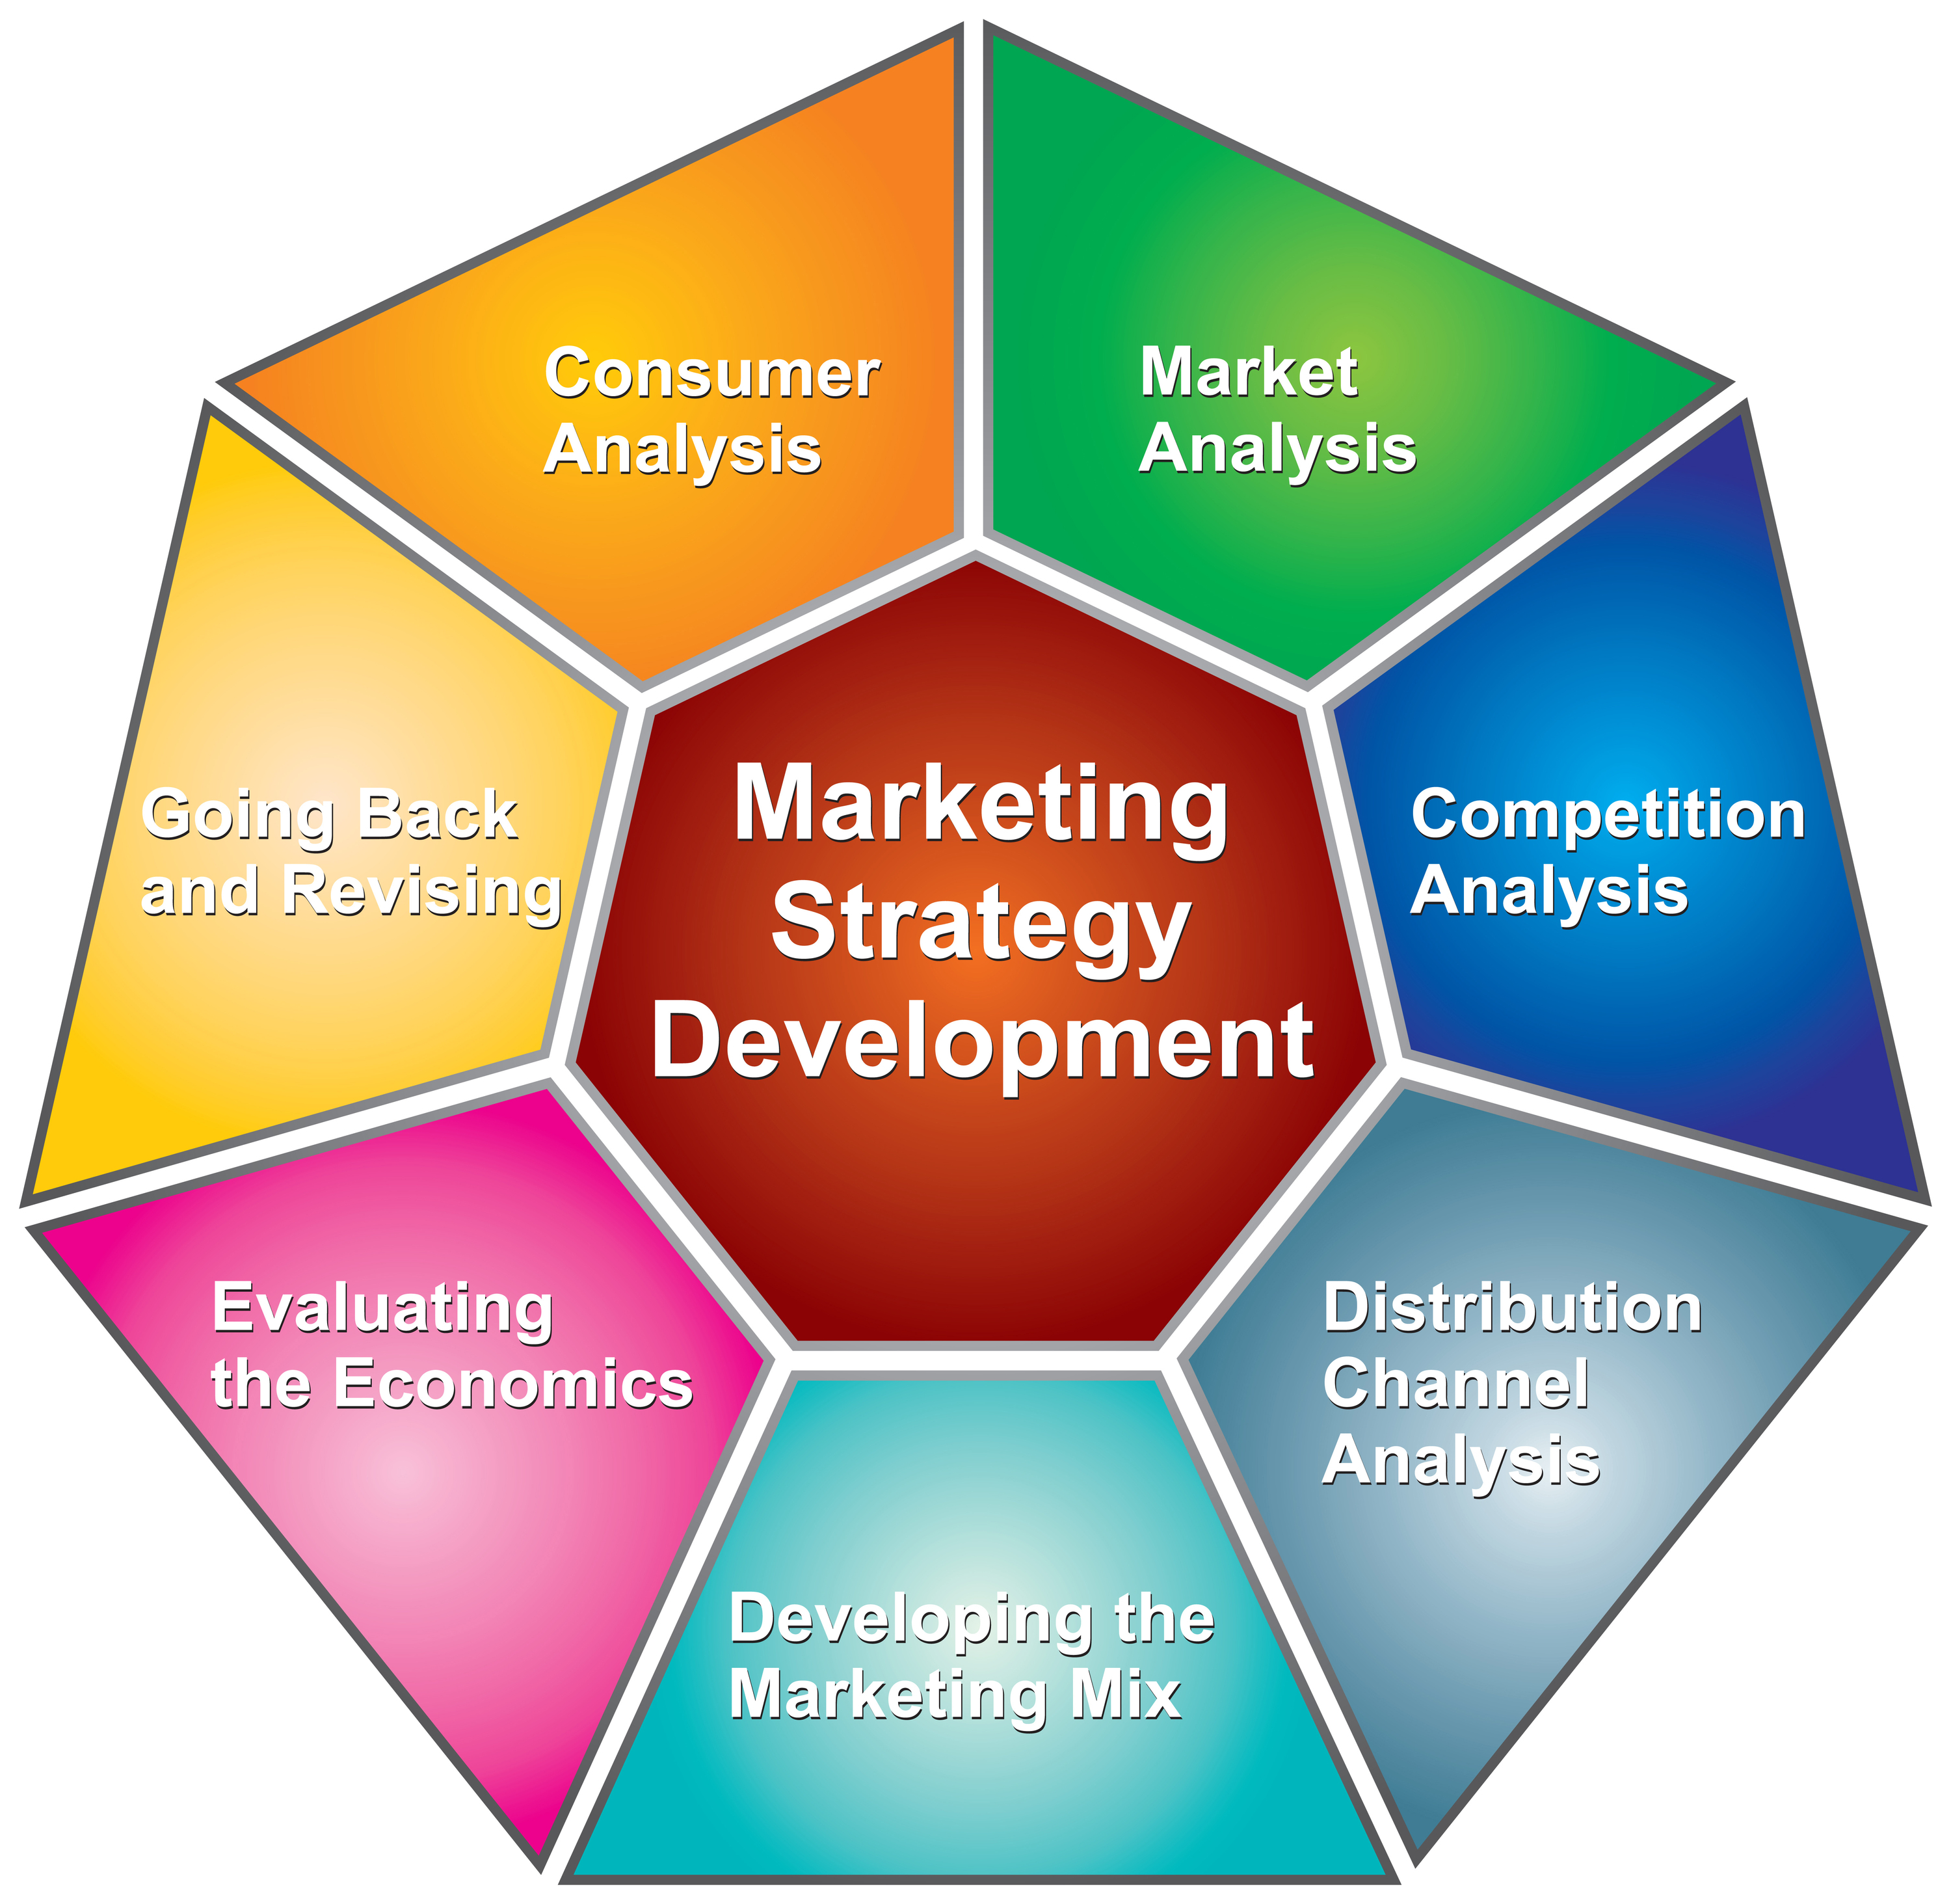
Product Overview
Customer Profile
Value Proposition
Product Roadmap
Strategic Features
The Competition
Industry Overview
Competitive Analysis
Product SWOT Analysis
Go to Market
Product Pricing
Marketing Plan
Product Launch Plan
Execution Plan
Our Team
Product Budget
Status Update
Up Next

Slide 15
Market Summary
Market: past, present, & future
Review changes in market share, leadership, players, market shifts, costs, pricing, competition
Mass Market/ Followers
Number
of customers
Early Adopters/
Pioneers
End of Life
Time

Slide 16
Product Definition
Describe product/service being marketed

Slide 17
Value Proposition
PRODUCT
CUSTOMER
Benefits
Simple
Experience
Everything Everywhere
Remember Everything
Features
Sync Across Devices
Include Images
Easy Syncing
Fast To Use
Never Forget
External Brain
Rich Metadata
Wants
Fast To Enter Things
Fears
Losing Things
Needs
Remember Things
Write Things Down
Share Notes With People
Single System
Locked Into A System
Save Information

Slide 18
Product SWOT Analysis
S
STRENGTHS
W
WEAKNESSES
O
T
OPPORTUNITIES
.
THREATS

Slide 19
Easy Optical Marketing Tips

Slide 20
Sponsorship and Community Involvement
If you're an eyecare practice in a rural area, maintaining a strong sense of community is a great way to build your customer base. Cost effective ways to create this bond and increase word of mouth is sponsoring local events such as a 5k run/walk, hosting educational classes at schools, or even a little league baseball tournament.
The opportunities are nearly endless as any community or charity event going on will be a great way to build positive brand awareness. Also, when you or your staff volunteers at different events, try to keep consistency and increase brand awareness by all wearing shirts with your practice's logo on it.
Notes:
Sports teams may welcome your practice as an eyecare consultant to help raise awareness of eye protection.
Patients who are coaches or athletes could be a good starting point to getting your foot in the door.

Slide 21
Promotion through Social Media
Signing up and being active on social media sites like Facebook and Twitter is completely free, other than the time it takes you to post and manage the content on your pages.
Maintaining up-to-date social media pages for your practice is an incredible way to stay connected with current and future customers, and is a great medium for showing some brand personality and having a little fun with your patients!
Notes:
Remember, people like doing business with people that they like, so if visitors can connect and build a relationship with you online, it's likely that you will be top of mind when they are searching for an Optometrist.
Be sure to pay attention and analyze your Facebook or social media results as patterns will develop and will help you determine what works and what doesn’t when targeting certain audiences.

Slide 22
Word of Mouth
Your current patients may be the most powerful marketing tool you have in your arsenal. If your practice is struggling, make your current patients the primary focus of your initial marketing efforts.
If you treat your current patients right, their recommendations to family and friends may do more to build your practice than you could ever do on your own.
There are ways to keep track, and reward, the patients who generate word of mouth referrals for your brand, such as a questionnaire on any new patient's visit. Sending gifts to patients who refer, say 3 or more, is a great way to show your appreciation to them.
Notes:
But remember, even if you are relying on word of mouth marketing, you should still develop a brand that best reflects how your personal practice operates, and ensure that everything you and your staff do supports your brand.
Strive to be consistent, accurate, and always deliver the level of patient care that is promised and promoted. The gifts don’t have to be expensive; the gesture is what's important here. People like recognition, but most importantly they love to get things for free

Slide 23
Outreach Programs
Senior centers, assisted living facilities, and retirement homes are places where you can speak and provide practical health information on cataracts, glaucoma, and other common age-related eye complications that senior patients experience.
Creating an outreach program with the senior audience will again get you further involved with your local community, and help create brand awareness for an audience who isn’t online or as tech-savvy as most other generations.
Notes:
A major factor to every successful marketing program is tracking your response rates and return on investment over time.
Watch your sales, new customers, and the demographics of those customers to help evaluate if your outreach programs are worth the effort and the time spent on them.

Slide 24
Positioning
Positioning of product or service
Statement that distinctly defines the product in its market and against its competition over time
Consumer promise
Statement summarizing the benefit of the product or service to the consumer

Slide 25
Communication Strategies
Messaging by audience
Target consumer demographics

Slide 26
Public Relations
Advertising
Strategy & execution
Overview of strategy
Overview of media & timing
Overview of ad spending
.
Strategy & execution
PR strategies
PR plan highlights
Have back-up PR plan, including editorial calendars, speaking engagements, conference schedules, etc.

Slide 27
Example of advertising

Slide 28
Pricing
Pricing
Summarize specific pricing or pricing strategies
Compare to similar products
Policies

Slide 29
Product Pricing
PRICE
ORIENTATION
CUSTOMER VALUE-BASED PRICING
COMPETITION BASED PRICING
COST-BASED PRICING
PRICE
REALIZATION
WEAK
MEDIUM
STRONG

Slide 30
Distribution
Distribution strategy
Channels of distribution
Summarize channels of distribution
Distribution by station
Show plan of what percent share of distribution will be contributed by each channel -- a pie chart might be helpful

Slide 31
Success Metrics
First year goals
Additional year goals
Measures of success/failure
Requirements for success

Slide 32
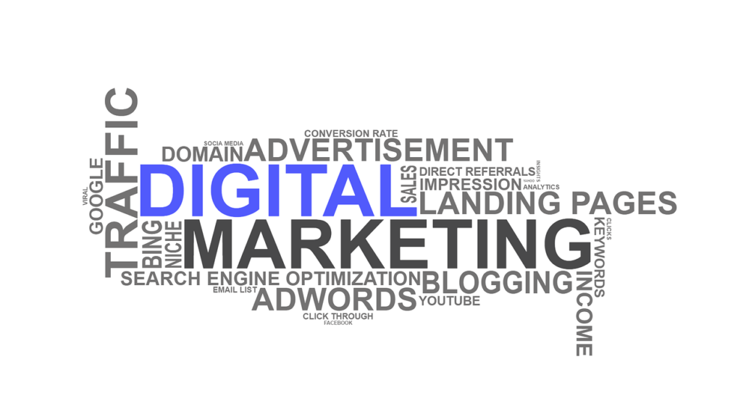

Slide 33
The seven most effective optometry marketing strategies
Search engine optimization (SEO) for optometry
Pay-per-click (PPC) advertisements for optometry
Content marketing for optometry
Social media marketing for optometry
Online reputation management for optometry
Email marketing for optometry
Start a referral program for optometry

Slide 34
Search engine optimization (SEO) for optometry
On Google Business a person can see the following thing about your business:
Location, customer reviews and photos of your office.
Accurate hours and appointment and staff information
Your phone number and other contact details

Slide 35
create a Network (even before making the website)
I agree it is not as easy as it sounds but a network is what professionals thrives on. This should be your first marketing strategy, creating a network. It is important to get yourself recognized; it gives others a reason to say something nice about you and your practice.
How?
You should network with other doctors; other OD’s as well as primary care doctors and pediatricians in your area. The better they know about you the better they are likely to send anyone your way.
Remember these three points when creating a network with others:
They should know who you are?
Where is your practice?
Why should they trust their patients with you?

Slide 36
Pay-per-click (PPC) advertisements
PPC advertising allows you to more specifically target your audience and more easily gauge the success of your advertising campaign than pretty much any other means of advertising.
These ads appear along with natural results at the top and sides of search engines, and you only pay for them when interested users click on them.
Notes:
Unlike traditional marketing techniques like newspaper ads or television commercials, PPC ads allow you to target your customers based on the keywords they’re searching online.
This is another reason that PPC is such a cost-effective strategy – because you’re not wasting your marketing budget on strategies that aren’t targeting your most qualified customers.
It’s also likely that your competition is using PPC ads, so it’s important to keep up in order to get the leads that you desire. And if they haven’t yet started using PPC ads, you’ll be ahead of the curve.
PPC ads help your practice focus on the most qualified leads, and bring users to your site as they’re actively searching for the services you provide.

Slide 37
Content marketing
Content marketing is exactly what it sounds like — using original content to attract your target audience to your site.
This content can take many forms, as long as it’s focused on topics that interest potential patients.
blogging about optometry or optometry related items not only are you up to date with technology but you also start earning their trust. Blogging about optometry-related topics shows that you’re good at what you do and you care about your profession.

Slide 38
Online reputation management
Use online review management and make it a part of your optometry marketing plan to encourage reviews and feedback from your clients, which can lead to more visits and even improvements to company policies.
Notes:
Online reputation management - Bing images

Slide 39
Social media marketing
Engage with your patients on Facebook, Twitter, and Instagram. Share pictures of new collections, promote specials, or talk about any seasonal discounts. Share fun facts with patients about eyes and vision they might not know, and educate them on the importance of contact lens care, annual eye exams, wearing sunglasses, a healthy diet, and so on.
https://www.vicimediainc.com/services/socialmirrorads/
Notes:
if you’re using social media as a optometrist marketing tactic, make sure you’re actually being social! It won’t do your optometry practice any good if your pages aren’t being managed and updated regularly. Also, remember to respond to any questions or comments that are posted on your pages in a timely manner.

Slide 40
Email marketing
Email marketing is one of the oldest forms of marketing, but it’s still one of the most effective for staying in touch with patients and encouraging repeat visits.

Slide 41
Start a referral program
show your appreciation and make sure to promote the program so they know how much you appreciate their referrals!
Patient referrals are not only the best compliment you can get but also a very trusted source that can easily convert strangers into patients.

Slide 42
Conclusion
whether it’s simply through word of mouth or through creative outreach programs, doesn’t have to cost you a lot of money or time, or cause you to stress. Marketing is simply influencing the choices of your patients by demonstrating the value of your service.
“Next to doing the right thing, the most important thing is to let people know you are doing the right thing.”
Marketing to potential new patients shouldn’t be seen as a tough sell, but rather a welcome invitation to get them the professional care you know you can provide!
Notes:
As John Rockefeller quoted

Slide 43
References
.
TELECORPORATE OPTOMETRY? O.D.s weigh the good, the bad, and future of using telemedicine in corporate practices, By Maria Sampalis, O.D, March 1, 2019
Optometry Marketing Ideas: The Ultimate Guide, by Hooman, July 2017.
10 Lessons I've Learned from Corporate Optometry, By Steven J. Lowinger, OD, October 15, 2013.
Managing the Business of Optometry, By Stephen M. Cohen, O.D, Scottsdale, Ariz, June 2008
Business Aspects of Optometry Association of Practice Management Educators, by John G. Classe
19 Optometry Marketing Ideas To Help Grow Your Practice, by Bradley Seegmiller
Grow Your Eye Care Practice: High-Impact Pearls from the Marketing Experts, Ming Wang, 2021

Slide 44
Thank you
Mrs. Diana Rabi BSc(Hons), MSc in ophthalmology and vision science. lecturer Optometry department, An-Najah National University Email: Dianehrabi@gmail.com Tel: +970-59-9534-538

