Slide 1
An-Najah National University
Creativity of Education
The Model of Palestine
Prepared by
Soheil Salha Saiada Affouneh Wasim Bishawi

Slide 2
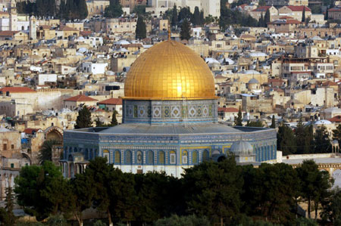

Slide 3
An-Najah Centenary

Slide 4
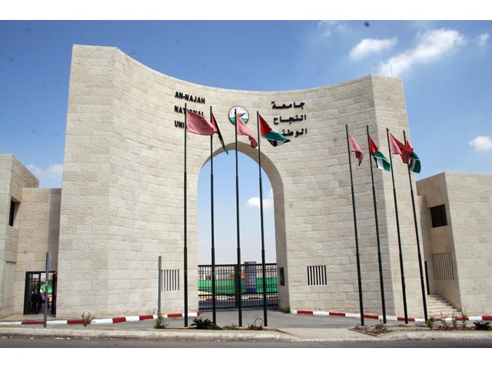

Slide 5
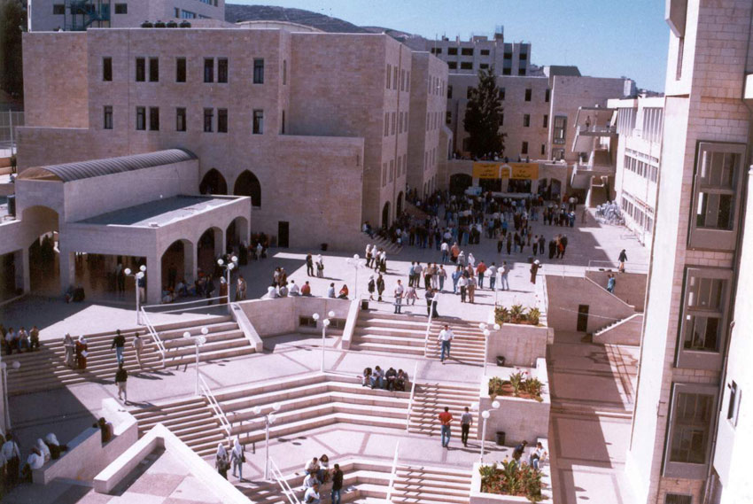

Slide 6
An-Najah University
A school in 1918.
Community college in 1948.
University in 1977.
82 B.A programs.
61 M.A programs.
4 Ph.D programs.

Slide 7
Palestinian Frame of Creativity
Believe
Challenge
Create

Slide 8
Believe
Independence is our target.
Education is our capital investment.
Our children have all the right to have future.

Slide 9
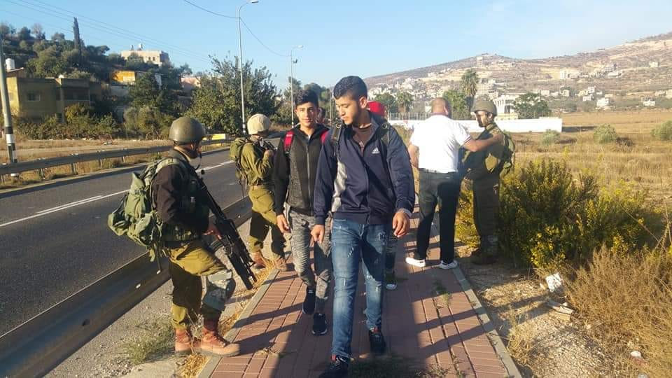
Challenge
The occupation.
The present to shape the future

Slide 10
Challenge
The increase on the demand for HE.
Poverty
The gap between education and labour market.

Slide 11
Create
New policies of Education.
New law of Higher Education.
New curriculum.

Slide 12
Create
Partnership
local.
Regional.
International.

Slide 13
Create
Community participation.
Private sector involvement.
Social responsibility.

Slide 14
Create
Localization :
Changing the project to programs.

Slide 15
Create
New trends of Research
(Interdisplinary, Multidisplinary)
Humanities and Scientific

Slide 16
Create
For whom love Palestine and can not visit,
Palestine create a visit
https://moodle.najah.edu/course/view.php?id=2386
https://www.youtube.com/watch?v=VvkbqiLhqRQ&feature=share

Slide 17
Opportunities
The motivation for education
Technology revolution
Youth are more than half of the Palestinians
The well to reform
The openness to the world
The support to the Palestinians

